Slide 1

Vehicle fuel costs analysis
Prepared specially for: Review site client
By DA: Kyle VanBuren

Slide 2
Project goal
Does switching fuel, drives, and vehicle types significantly impact the following?
Miles per gallon
CO2 consumption
Save or spend (5-year)
Electricity consumption (specifically electric vehicles)

Slide 3
Hypotheses
1. Null Hypothesis 1 (H0):
Switching fuel types has no effect on city & highway MPG
1a. Alternate Hypothesis 1 (Ha):
Switching fuel types does influence city & highway MPG
2. Null Hypothesis 2 (H0):
Switching vehicle drives has no effect on 5-year savings
2a. Alternate Hypothesis 2 (Ha):
Switching vehicle drives does influence 5-year savings
3. Null Hypothesis 3 (H0):
Switching fuel types has no effect on tailpipe Co2 levels
3a. Alternate Hypothesis 3 (Ha):
Switching fuel types does influence tailpipe Co2 levels
4. Null Hypothesis 4 (H0):
Switching terrain has no effect on electricity consumption.
4a. Hypothesis 4 (Ha):
Switching terrain does have an effect between electricity consumption

Slide 4
Process
Collect data on city & highway MPG from the provided data from the company
Collect data on both front and rear wheel drive from the provided data from the company
Collect data on vehicle types, electricity & CO2 consumption from the provided data from the company
Conduct statistical analyses to see if there happened to be any statistically significant difference between fuel, drive, and vehicle types when comparing the continuous data provided from the company: https://www.kaggle.com/datasets/epa/fuel-economy

Slide 5
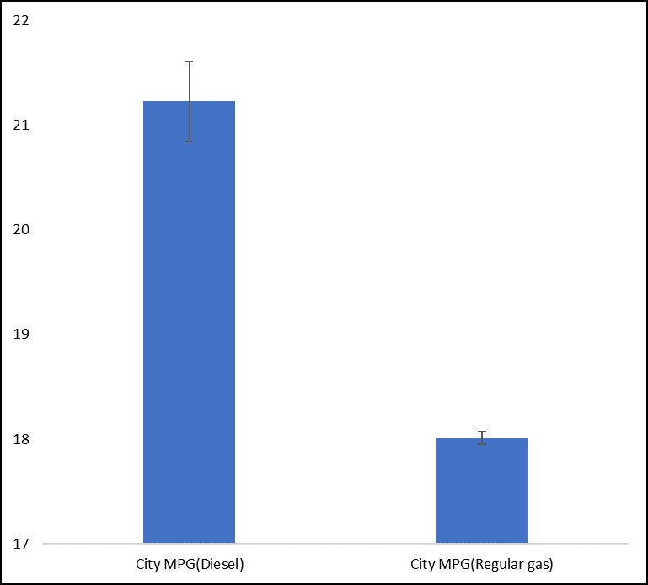
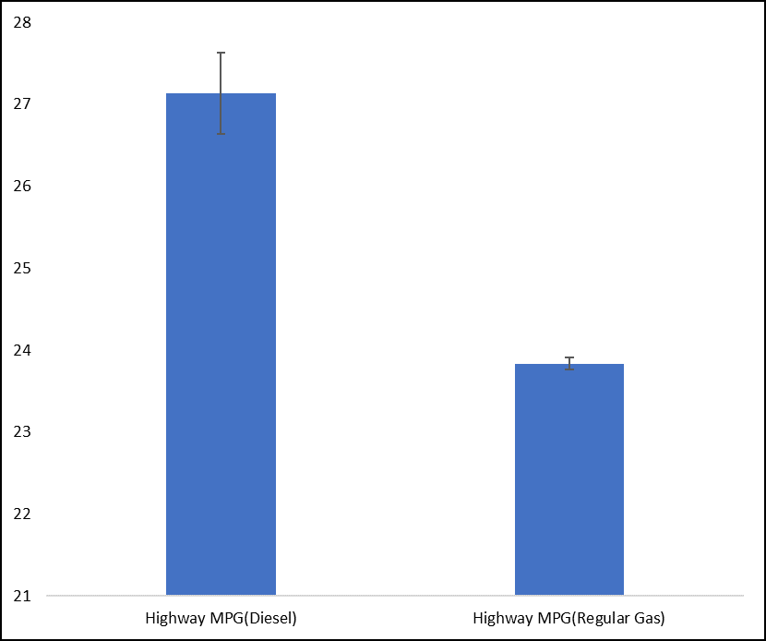
Analysis of MPG on fuel types
(The null hypothesis is rejected)
Conclusion: There is significant difference between city & highway mpg when it comes to different fuel types.

Slide 6
Analysis of front & rear wheel drive on spend and save (5-year)
(The null hypothesis is rejected)
Conclusion: There is significant difference between spend & save when it comes to different vehicle drives.

Slide 7
Analysis of Tailpipe Co2 on fuel types
(The null hypothesis is rejected)
Conclusion: There is significant difference between tailpipe Co2 levels when it comes to different fuel types.

Slide 8
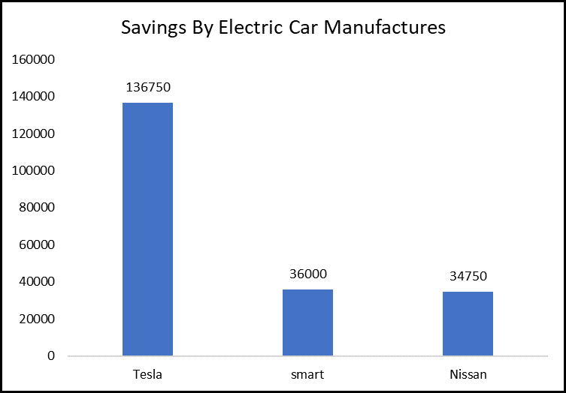
Analysis of Tesla on city & highway electricity consumption
(The null hypothesis is rejected)
Conclusion: There is significant difference between electricity consumption when it comes to different terrain.

Slide 9
Final message
The statistical analyses showed that switching fuel, terrain, drives, and vehicle types:
Does have a significant positive impact on MPG
Does have a significant positive impact on CO2 consumption
Does have a significant positive impact on Save or spend (5-year)
Does have a significant impact on Electricity consumption (specifically electric vehicles)
Next slide for recommendations:

Slide 10
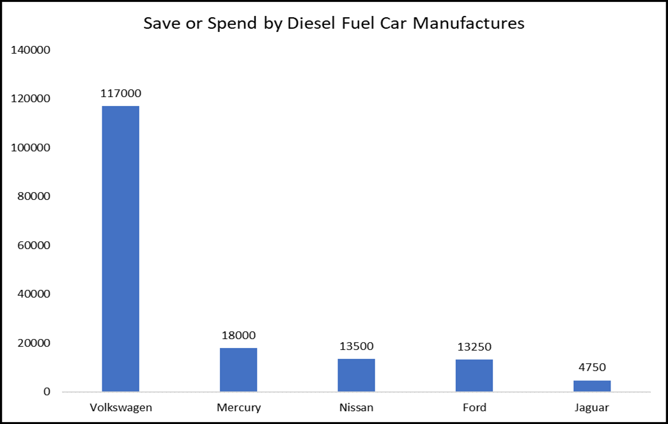
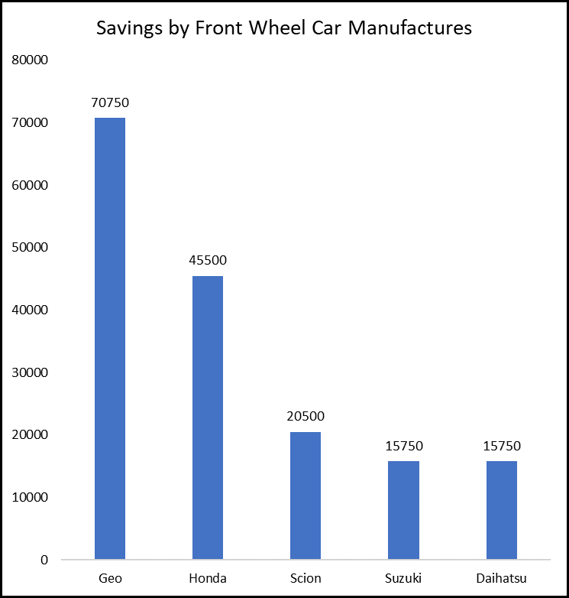
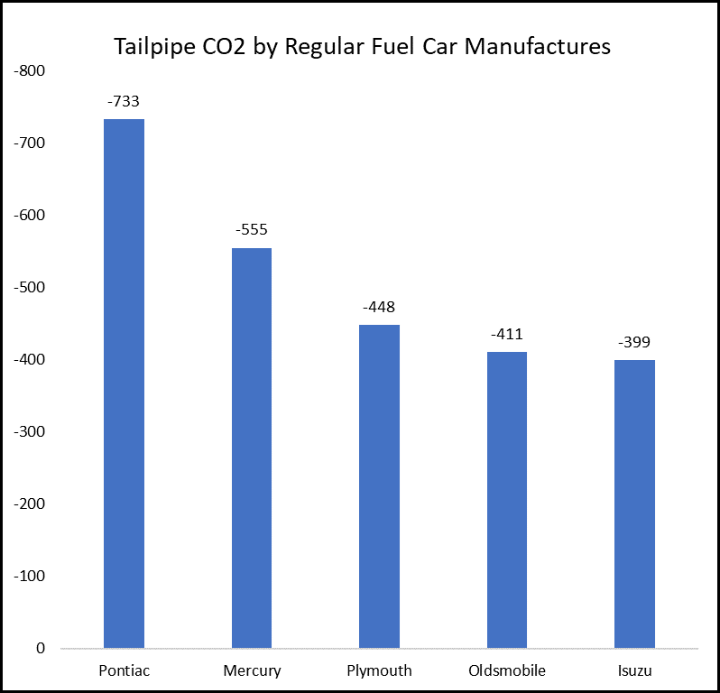
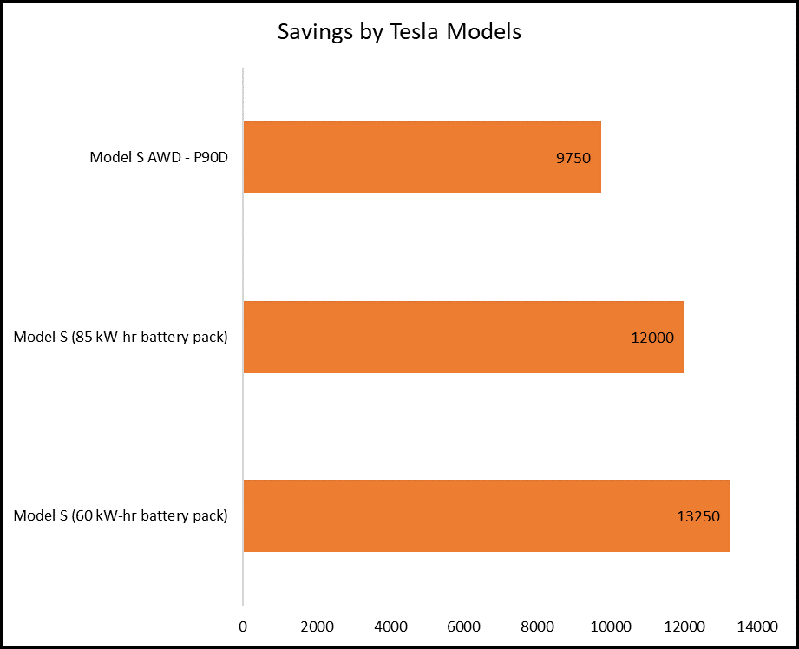
Recommendations
For increased results on MPG go with Volkswagen(diesel fuel)
For increased results on savings with a 2-drive vehicle go with Geo
For increased results on low Co2 consumption go with Pontiac(regular fuel)
For increased results on savings with tesla go with Model S (60kw-hr)

